Slide 1
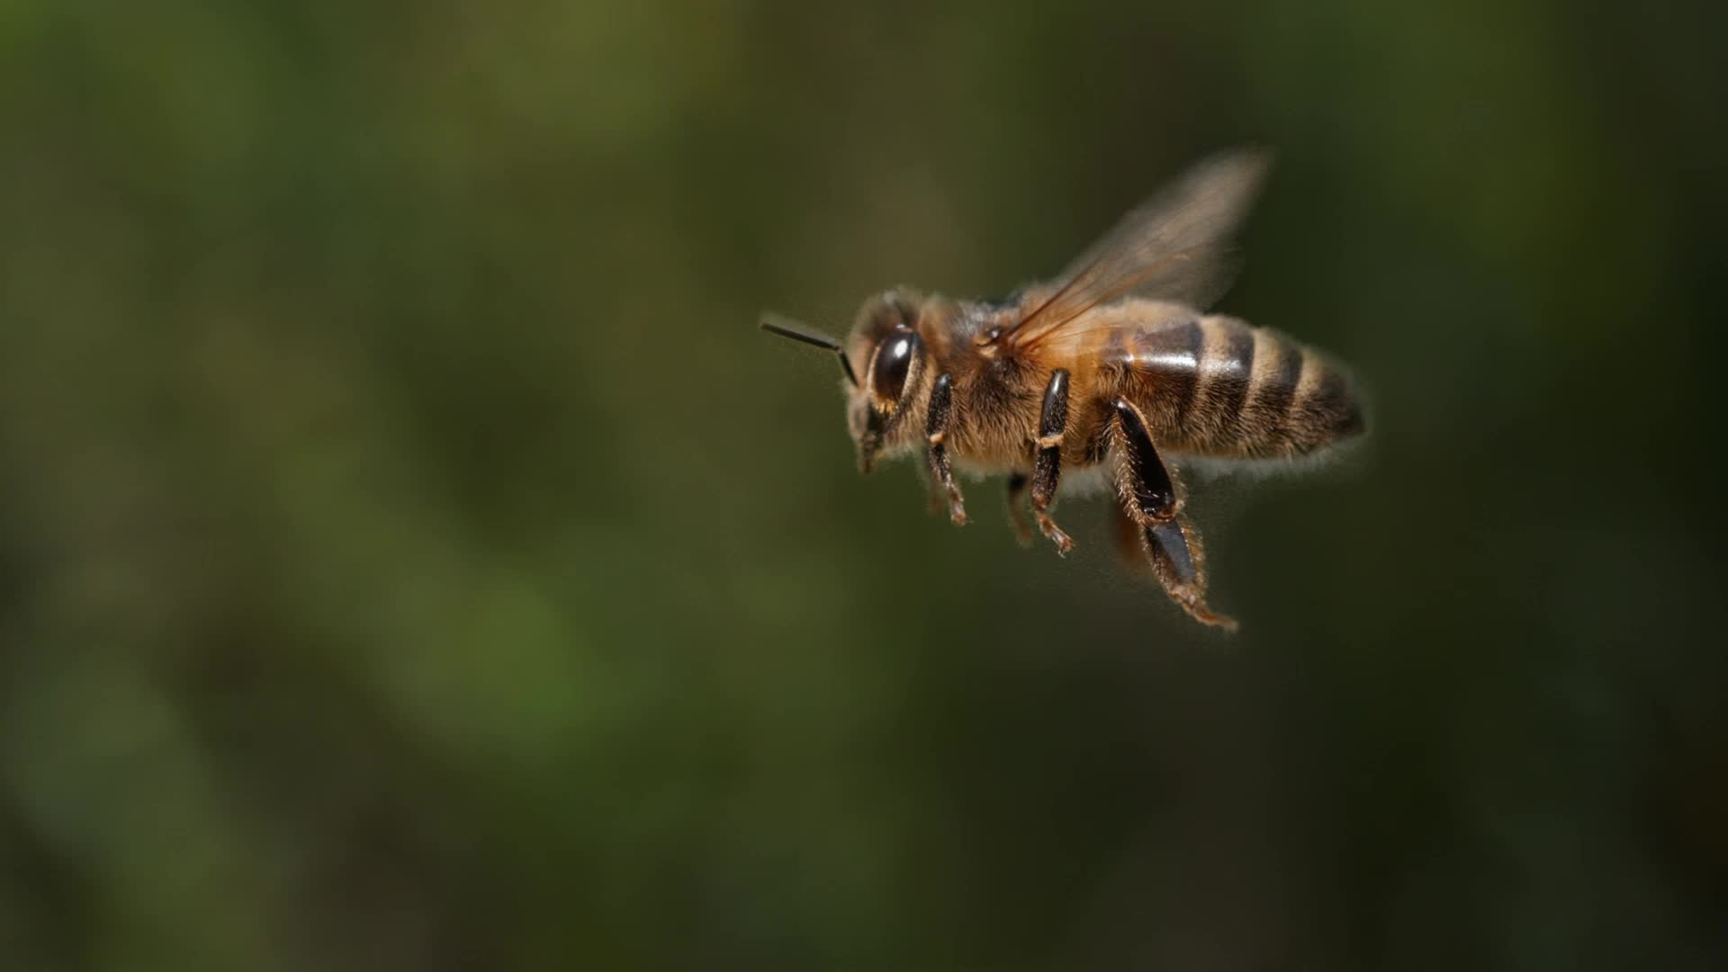
Bee Pests & Diseases

Slide 2
Presentation
This presentation will:
List the major bee pests and diseases.
Discuss the general practices you can take to mitigate and manage the main bee pests and diseases.
Discuss Varroa Mite (exotic).
Provide sources for further information.

Slide 3
Overview
There are many pests and diseases that affect bees.
Currently most are managed by strong colonies with good hygiene behaviours supported by good beekeeper practices.
When Varroa arrives it will be a different ball game.
There is lots of good information on identifying, mitigating and managing pests and diseases. Use them

Slide 4
Exotic: Must be reported immediately
Tracheal mite (Acarapis woodi)
Tropilaelaps mite (Tropilaelaps clarae)
Varroa mite (Varroa destructor and Varroa jacobsoni).
Acute bee paralysis virus (Cripavirus)
Aphid lethal paralysis virus strain
Apis iridescent virus (iridovirus)
Deformed wing virus (iflavirus)
Egypt bee virus
Lake Sinai virus – strains 1 and 2
Large hive beetle (Hoplostoma fulgineus)
Phorid fly (Apocephalus spp. incl A. borealis)
Slow bee paralysis virus

Slide 5
Exotic Bees must be reported immediately
Black dwarf honey bee (Apis andreniformis)
Red dwarf honey bee (Apis florea)
Giant Philippine honey bee (Apis breviligula)
Asian honey bee (Apis cerana)
Giant honey bee (Apis dorsata)
Cape honey bee (Apis mellifera capensis)
African honey bee (Apis mellifera scutellata)
Bumblebee (Bombus spp.)
Hornet (Versa spp.)

Slide 6
Report without delay
American Foulbrood

Slide 7
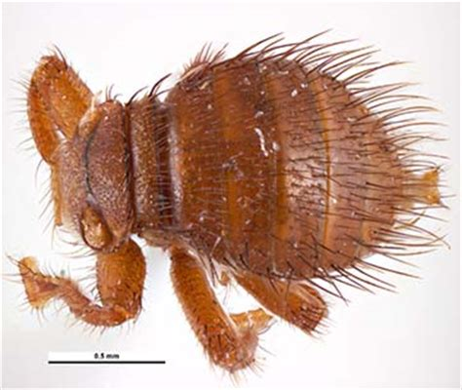
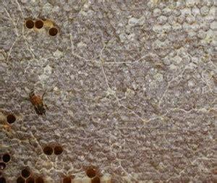
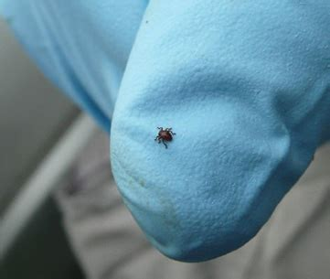
Report within 12 hours
Braula fly (currently not found outside of Tasmania)

Slide 8
Report within 7 days
Chalkbrood disease
European Foulbrood disease
Nosema (Nosema apis)

Slide 9
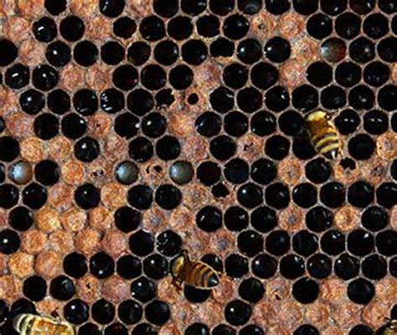
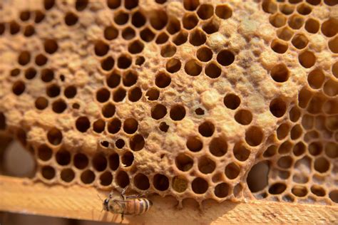
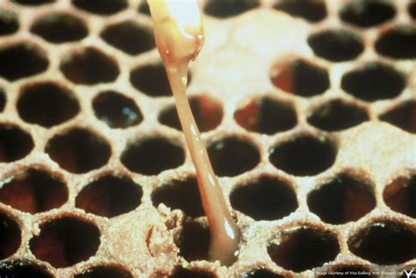
American Foulbrood

Slide 10
American Foulbrood
Bacterial infection
Tests:
Observation of brood
irregular brood pattern and colour
sunken caps of the cells
some caps may be perforated.
Matchstick test
Laval smear testing
Honey sample testing

Slide 11
American Foulbrood
Actions:
Report suspected AFB to 136 186 or email honeybee.biosecurity@agriculture.vic.gov.au
Follow instructions
Likely outcome – bees destroyed, and hive burnt or irradiated.

Slide 12
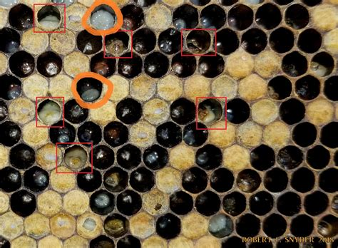
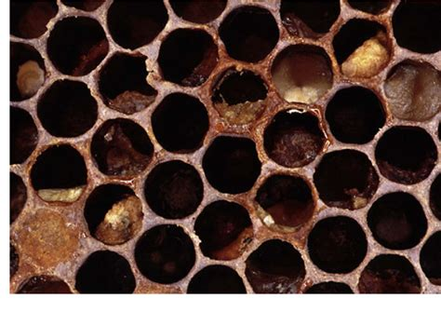
European Foulbrood disease
Bacteria

Slide 13
European Foulbrood disease
Actions
Minimise stress on hives
Quarantine the hive and disinfect in and out
Replace infected and old frames or undertake a ‘Shook Swarm’
Ensure bees exhibit good hygienic behaviour – replace the queen

Slide 14
AFB and EFB spread factors
Natural methods of spread:
Drifting
Swarming
Robbing
Beekeeper methods of spread:
Moving infected combs from one colony to a healthy colony
Uniting a weak (diseased) colony with a stronger colony
Feeding honey from a dubious source to bees
Trapping pollen from infected colony and feeding to healthy colony
Inspecting hives with dirty gloves and suit after inspecting an infected colony
Hiving unknown swarms near healthy colonies
Buying old equipment without cleansing before use
Moving bees to area with large numbers of colonies close by, e.g. pollinating sites
Purchasing infected stock of bees

Slide 15
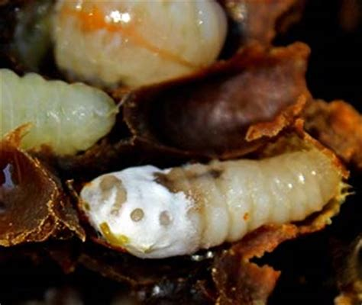
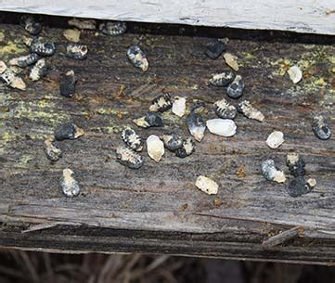
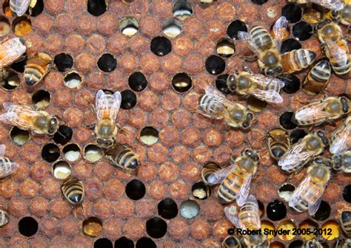
Chalkbrood disease
Fungal growth
More common in spring and autumn when humidity is high.

Slide 16
Chalkbrood disease
Actions
Have strong dry hives with good ventilation.
Ensure bees exhibit good hygienic behaviour – replace the queen.
Feed hives with chalkbrood that are under stress
Replace infected and old frames

Slide 17
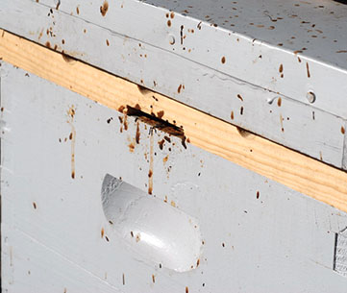
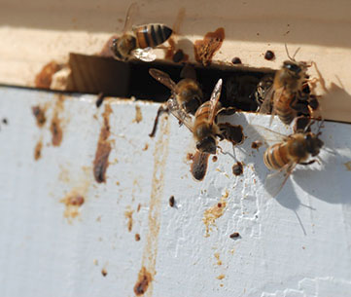
Nosema disease
Caused by two species of microsporidian parasites (a type of spore forming fungus) called Nosema apis and Nosema ceranae.

Slide 18
Nosema disease
Actions
Keep strong health hives
Minimise stress on hives especially during winter
Replace infected and old frames
Ensure bees exhibit good hygienic behaviour – replace the queen.

Slide 19
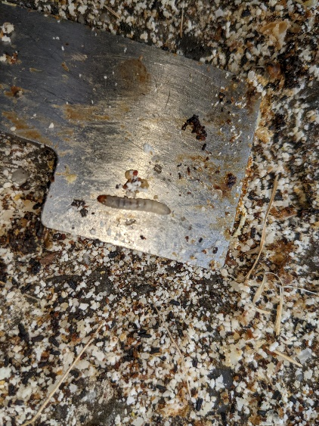
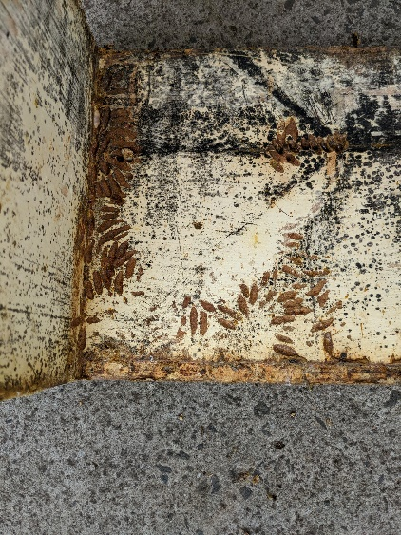
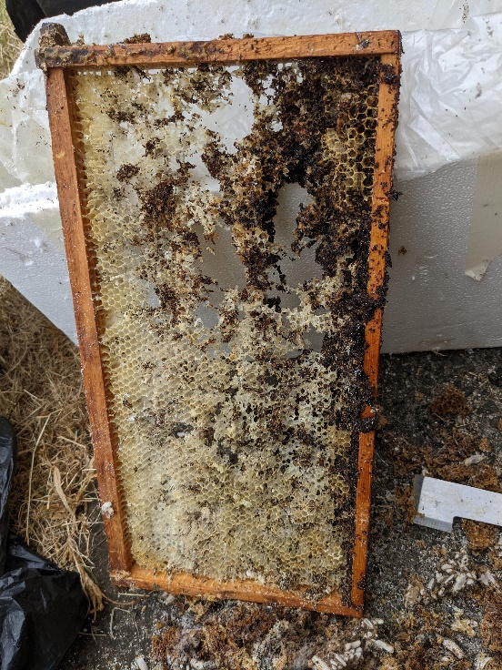
Wax Moth (reporting not required)
Actions
Keep strong health hives
Keep hives clean
Freeze frames (2 days) and store to prevent infestation
Clean stored boxes.

Slide 20

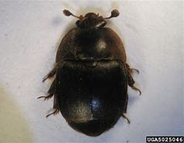
Hive Beetle (reporting not required)
Actions
Keep strong health hives with bees working in all boxes
Keep hives clean
Do not leave wax and hive debris about
Freeze frames (2 days) and store to prevent infestation
Clean stored boxes
Use traps if required.

Slide 21
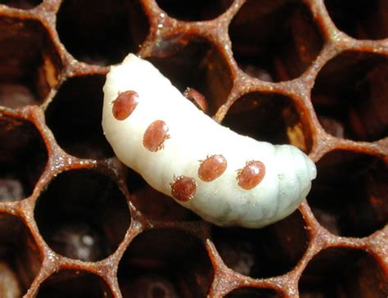
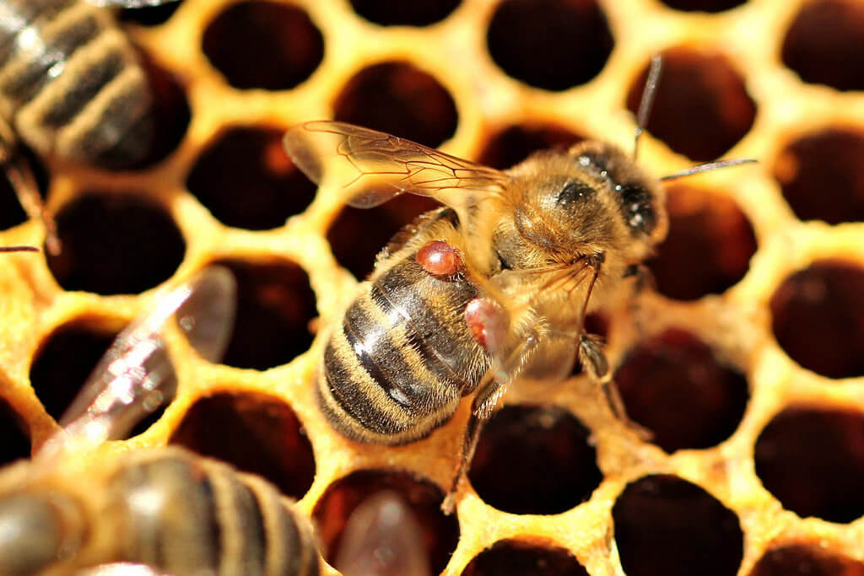
Varroa Mite
Originally an Asian honey bee mite that was introduced to European honey bees in the early 20th century
They feed of the fatty bodies in the ‘blood’ of bees
They weaken bees and the hive and provide a vector for other diseases and pests.
Currently Australia is the only country that does not have Varroa.

Slide 22
Impact of Varroa
As a result of Varroa between 40% to over 50% of hives in the US die each year.
Increased levels of pesticide in hive produces - honey, wax and pollen.
Significant reduction of wild colonies resulting in poorer pollination outcomes for many plants and crops.
Higher costs and increased workload for beekeepers.
Substantial reduction in backyard beekeeping.

Slide 23
What can you do
Register your hives to support Response Team’s inspections
Undertake Varroa inspections at least twice a year.
Do not screw your base to the brood box.
Prepare for Varroa and know what manage actions you will adopt.

Slide 24
Summary
Register your hives
Know your pests and diseases and what to do
Maintain strong health hives
Do regular inspections
Keep your equipment clean and replace foundation in frames every 3 to 4 years

Slide 25
References and Information
Bee Aware website
Agriculture Victoria - bees website
Australian Beekeeping Guide (2014)
Biosecurity Manual for Beekeepers
Plant Health Australia – Biosecurity Online Training (BOLT)
Bee Health app (Alberta)

