Slide 1
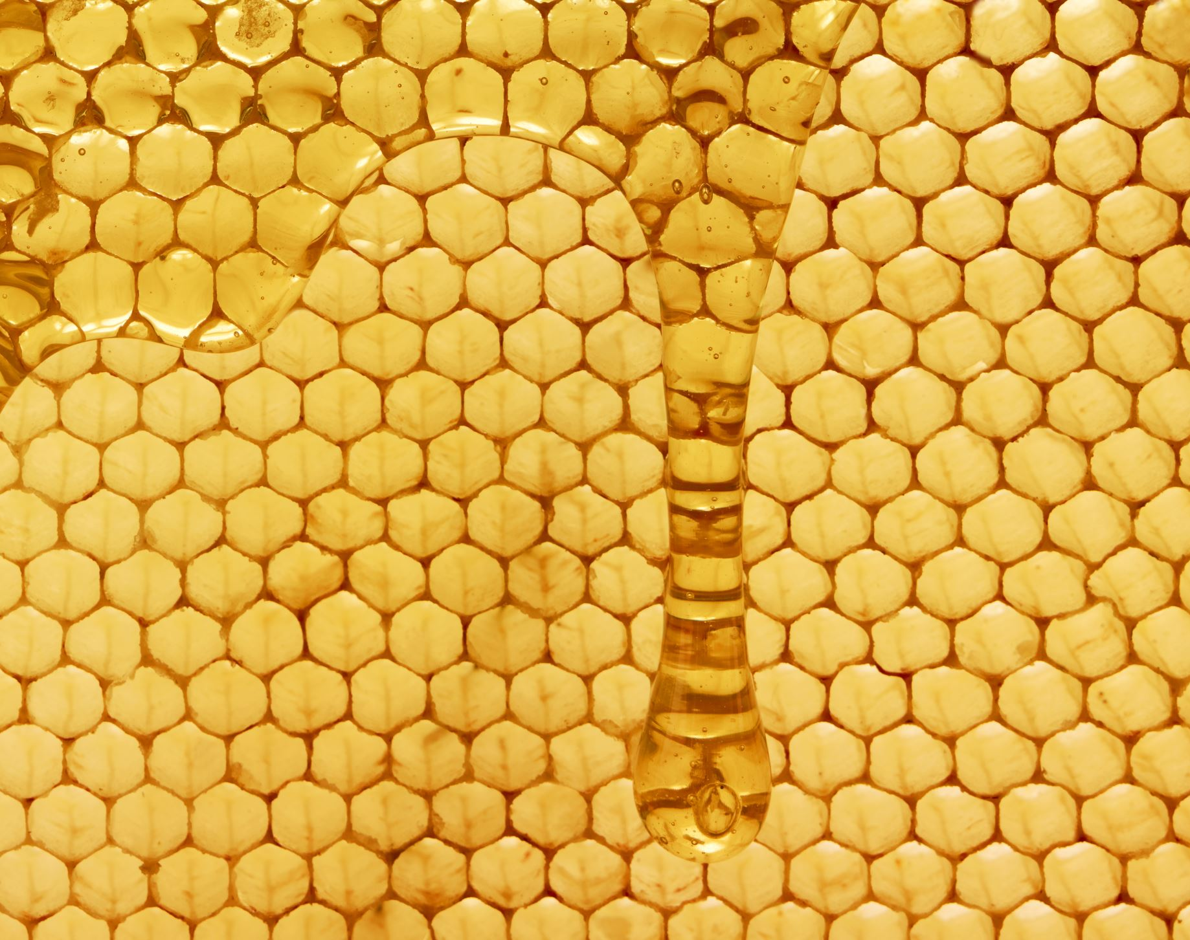
Extracting honey

Slide 2
I wont recreate the wheel
For info and options on how to extract go to:
https://www.betterbee.com/instructions-and-resources/how-to-extract-honey.asp
Or
This month’s copy of the The Australian Beekeeper

Slide 3
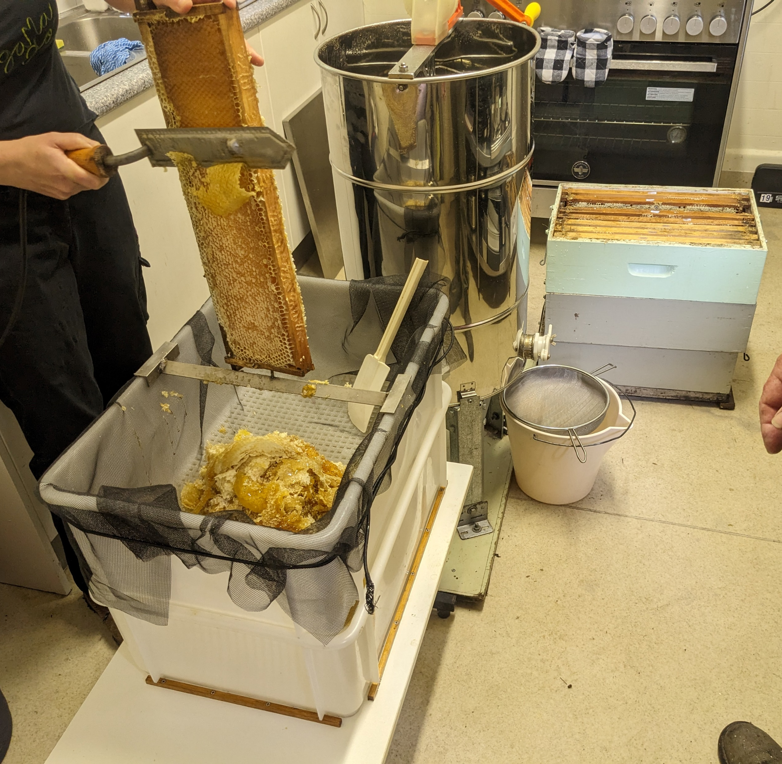
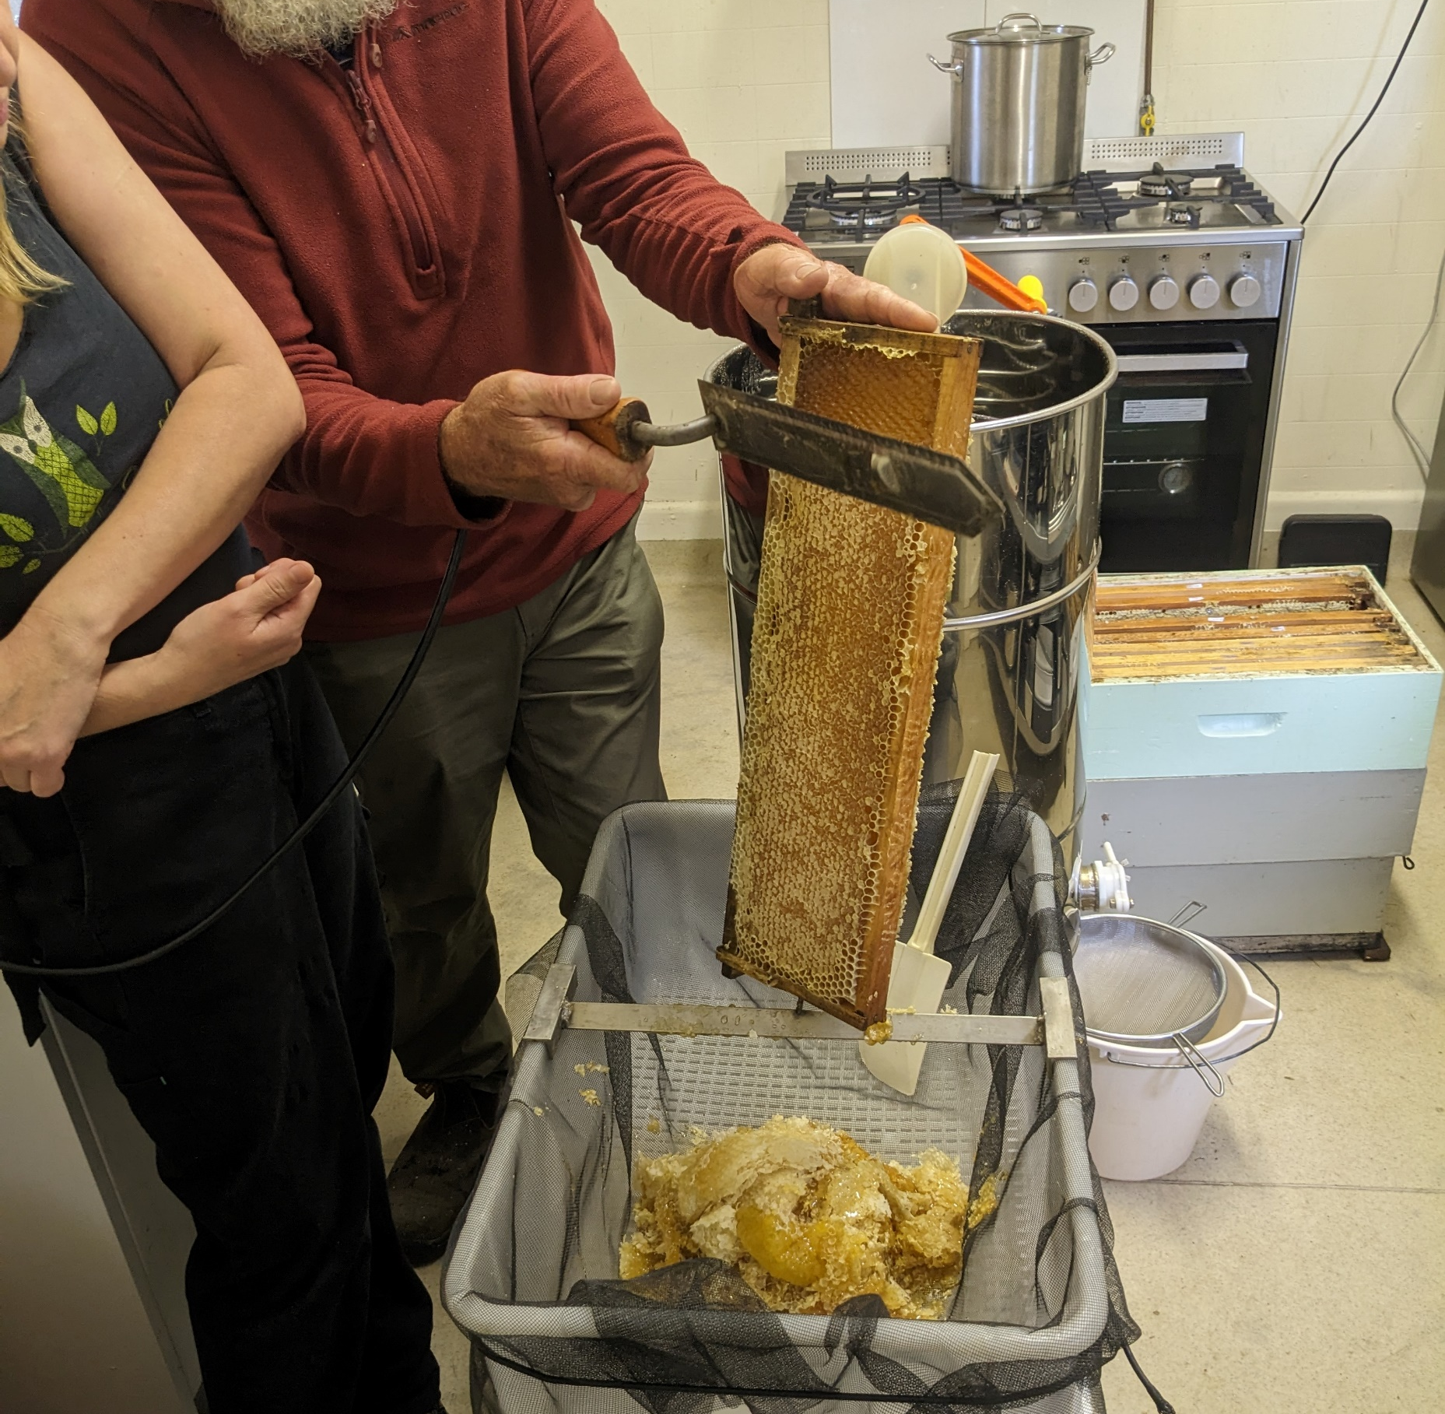
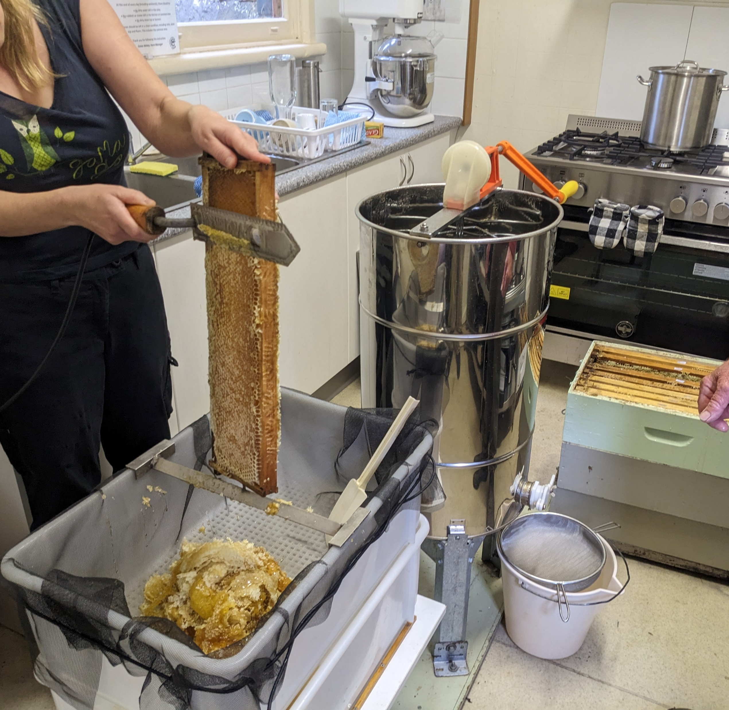

Slide 4
Tips and tricks (1)
Extract while the honey is warm.
Use a bee escape board to clear honey boxes
A plastic container box with a piece of wood and nail for decapping is an option.
A paint strainer bag over a food grade container can be used to sieve the honey. Use piece of string to tie the strainer bag on the container.
Or extract straight into the container, leave for a few days and scrape off the wax that will be on top of the honey and use plastic film to finish off.
Or use more than one container with sieves as flow through sieves may be slow, especially in cool weather.

Slide 5
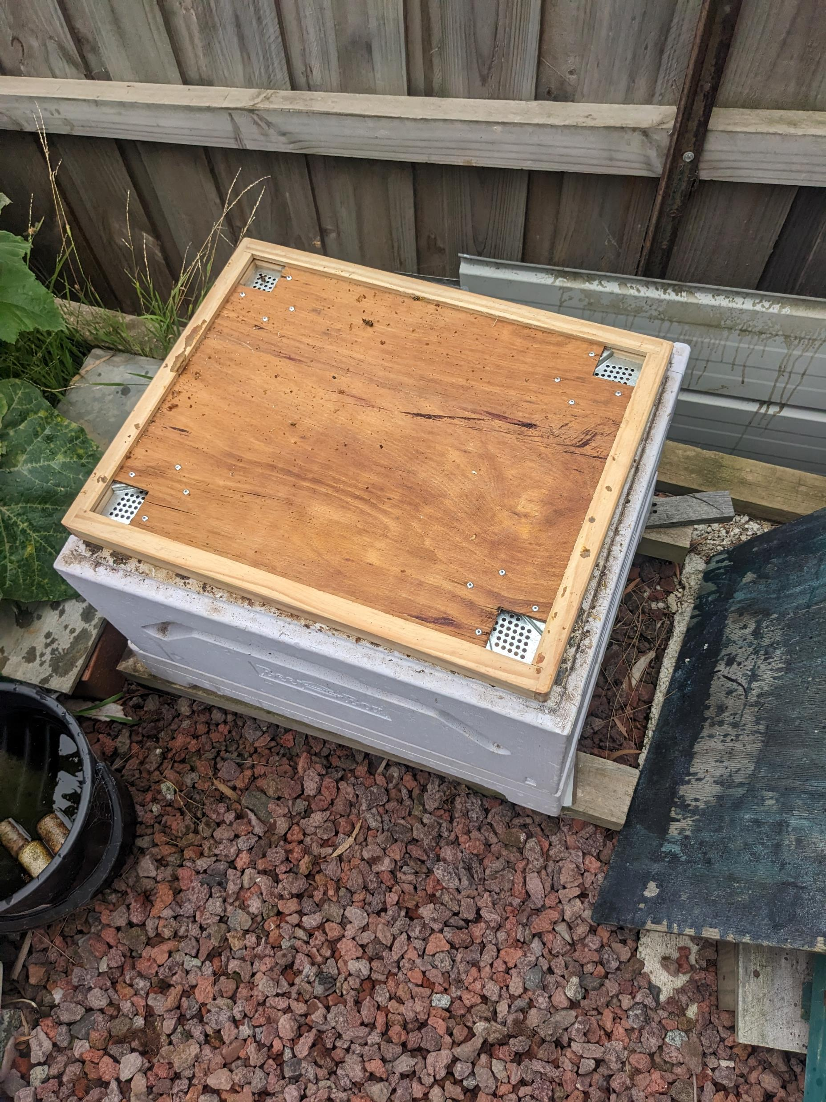
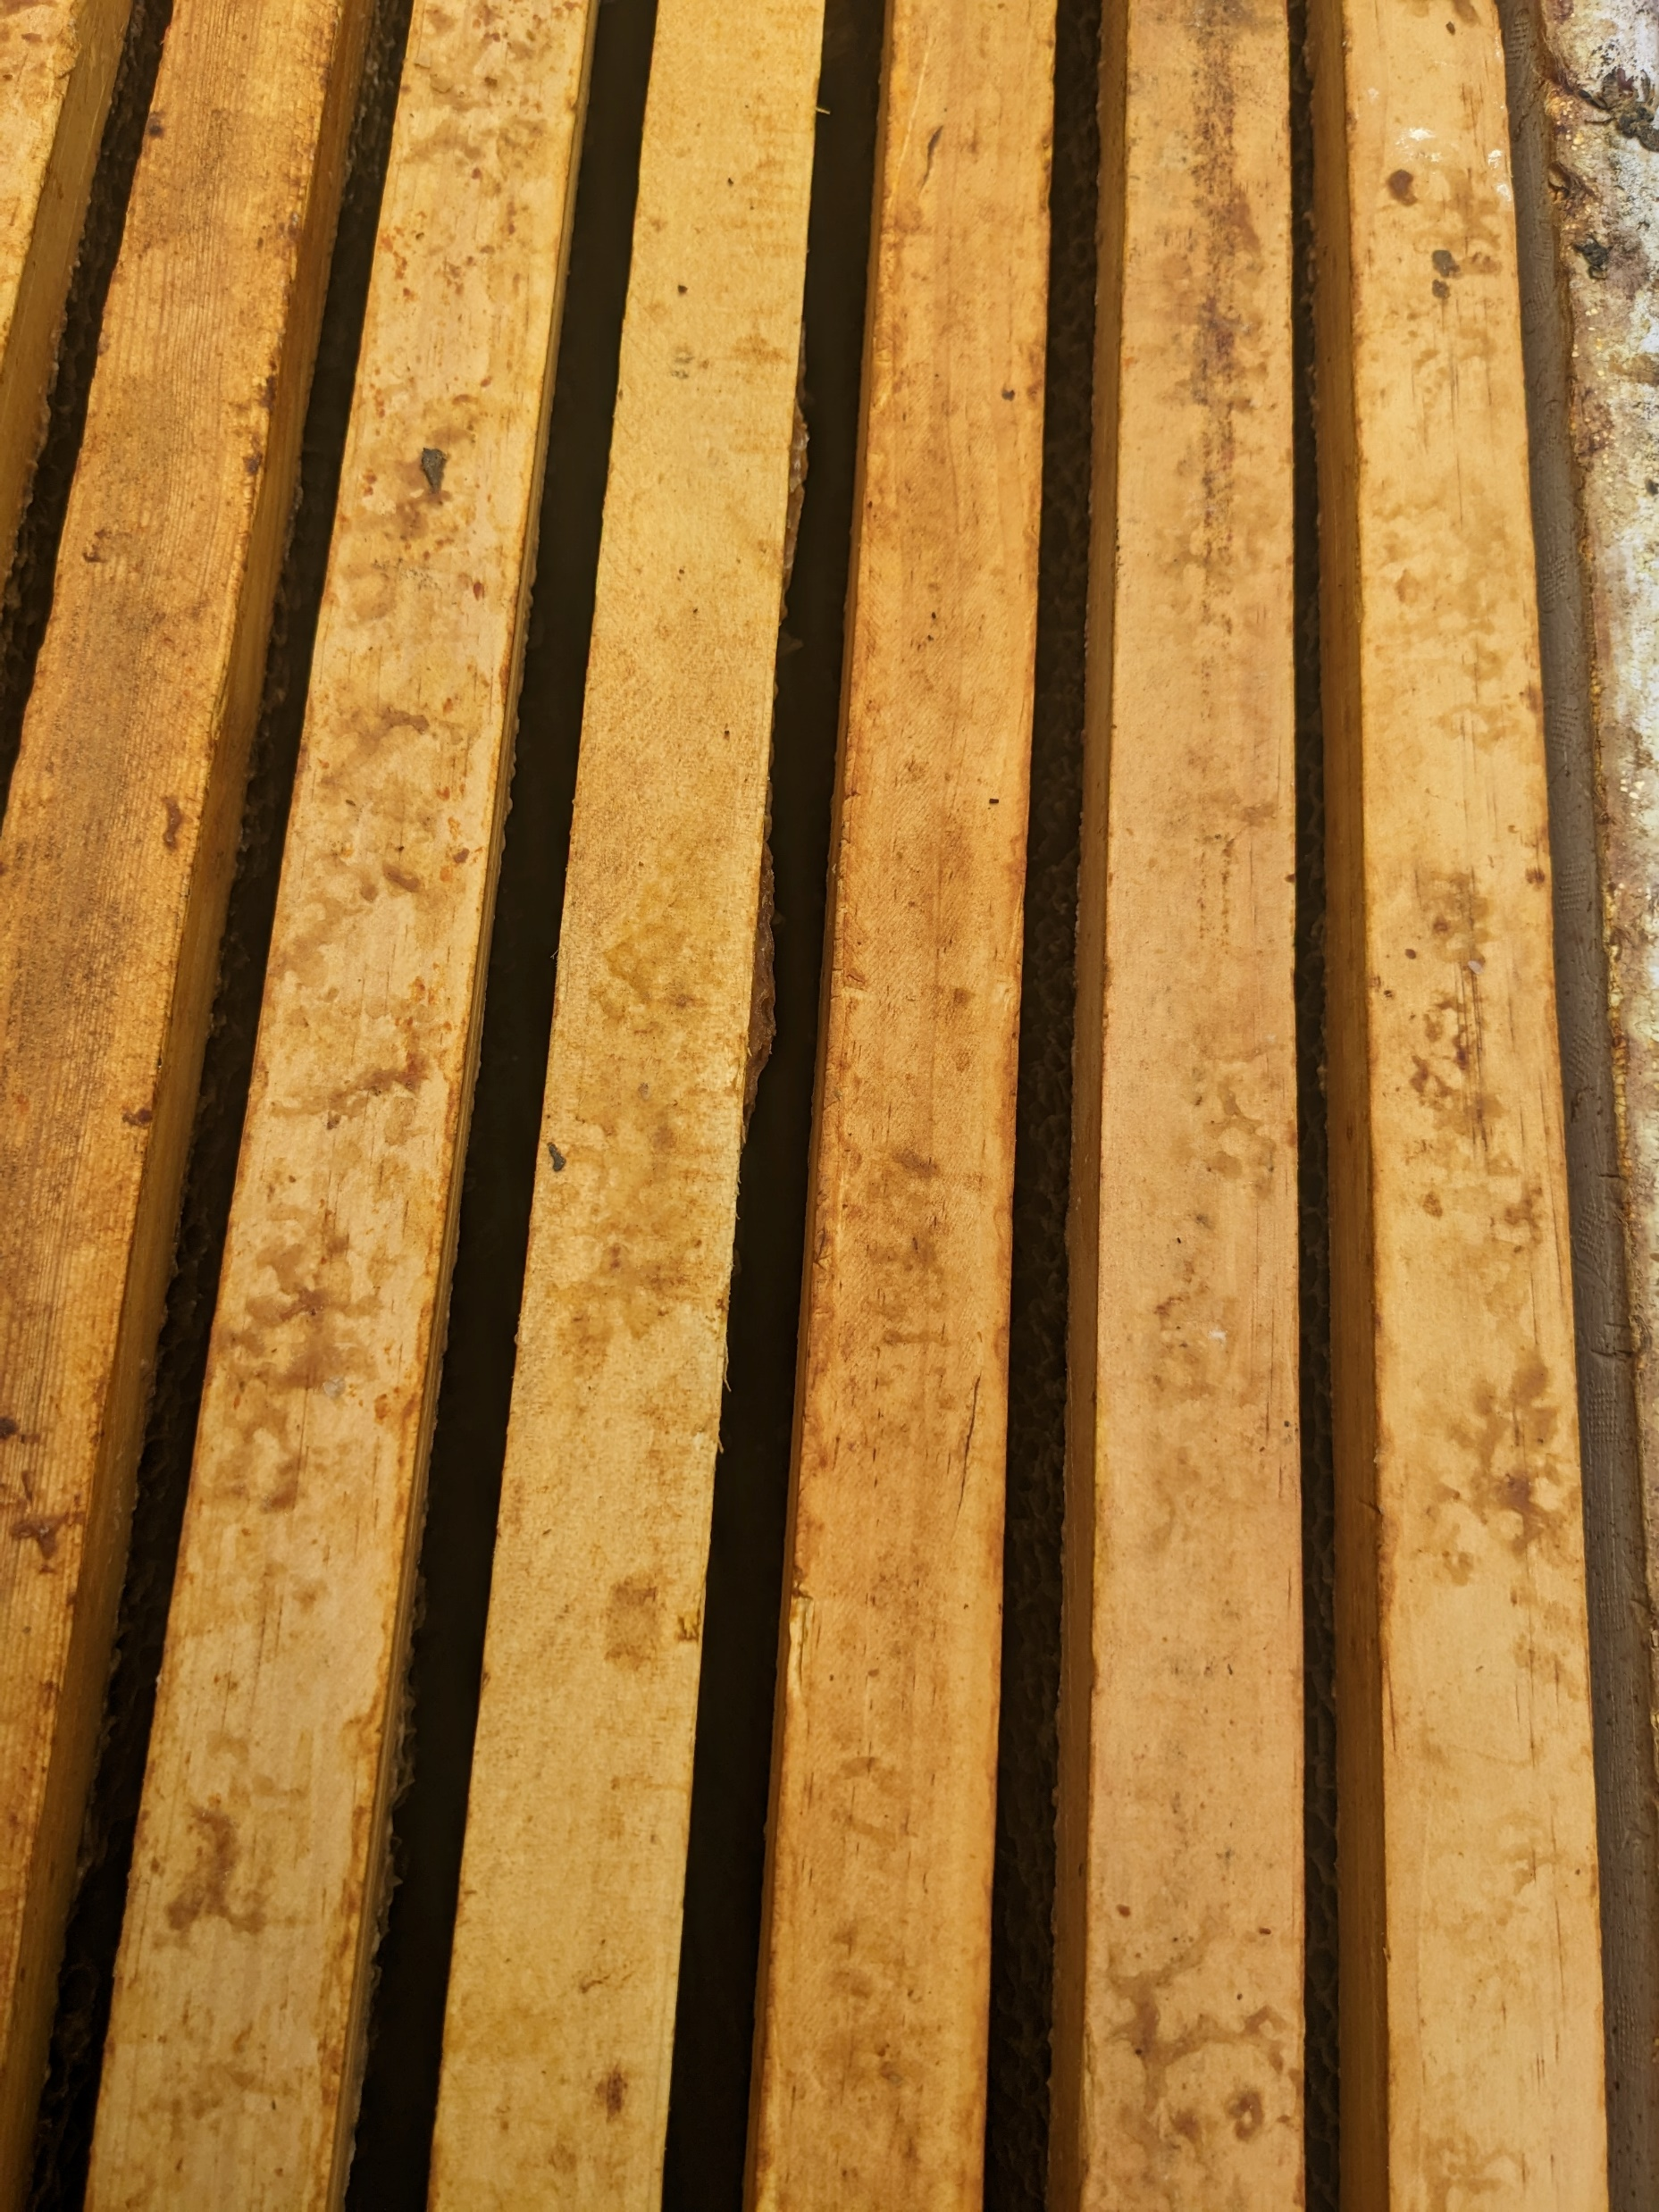
Clearer board and the result

Slide 6
Tips and tricks (2)
Put the cappings in a paint strainer bag and hang in a bucket for few days to get most of the honey out.
When finished, tie the bag and wash 2 or 3 times in a bucket with cold water to remove remaining honey. Then hang to dry.
Wash extraction gear in cold water first to remove wax etc.
Use non-scratch clothes on plastic. Stainless steel pads on stainless steel. No detergents or chemicals. Hot water for dissolving honey.
Have the bees clean out stickies and partially filled honey frames.
Bottle after a few days to allow the honey to settle but not to get cold.

Slide 7
April jobs
Finnish taking your honey off – leave enough for your bees – 4 to 5 frames depending on the circumstances.
Prepare for pack down:
- 1 or 2 boxes for 8 frame wooden hives – no queen excluder and top box full of honey.
- 1 box for 10 frame wooden or polystyrene hives.
- Leave no empty frames or spaces.
- Anzac Day is a good marker for pack down.
Undertake Varroa tests: sugar shake, alcohol wash and drone uncapping.
Report your findings on BeeMax.
Sort, freeze and store unused frame.

Slide 8
Ants
Argentine Ants are more of a problem to bees that I thought.
In NZ they have been found to overwhelm hives, kill bees and brood, steal the honey and spread Deformed Wing Virus.
In Victoria there is a major problem with Argentine Ants. A giant colony of ants has been discovered spanning 100km across Melbourne.
Actions:
see https://www.agric.wa.gov.au/pest-insects/argentine-ants?page=0%2C0 for advice on identification and treatment.
Reduce their access to water and food.
Ensure that ants are not nesting in the hive or near it.
Using grease or petroleum jelly on stand legs is a short-term solution as dirt will quickly cover it.

